Slide 1
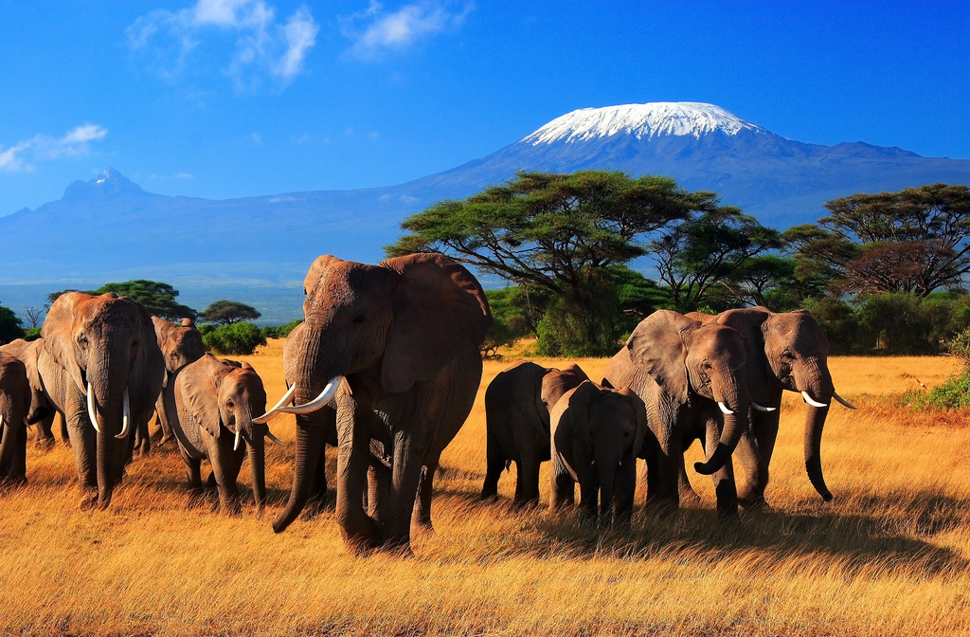
The Great Eight Unit Elephant Slides
Notes:
Created by Vanessa Morris-O’Hearn, morris-ohearnv@cvuhsd.org

Slide 2
This is Part I of the Elephant Slides.
Please do these at your own pace, filling in highlighted portions on most slides and/or worksheet
Thanks for your hard work on slides

Slide 3
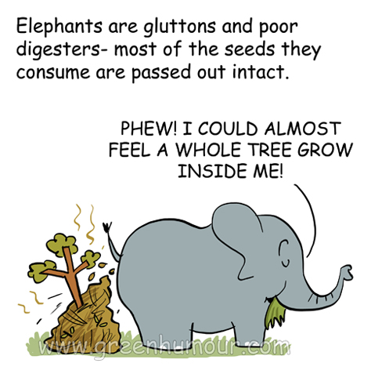
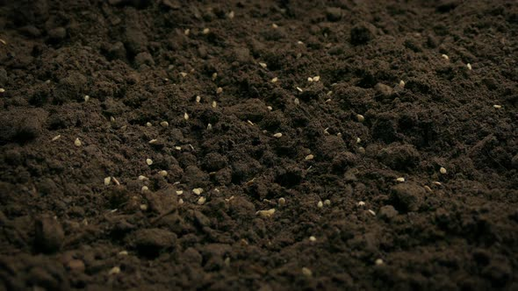
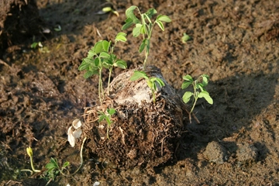
Teacher notes
Elephant poop recipe

Slide 4
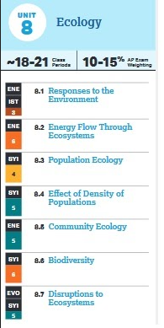
Worksheet 1 (8.5 + 8.6 + 8.2)

Slide 5
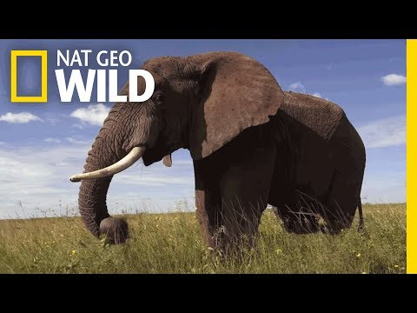
Watch this video.
What surprised you the most about elephants?
-
-
https://web.microsoftstream.com/video/1b3589b7-09dd-49be-8985-8cba19630f52

Slide 6
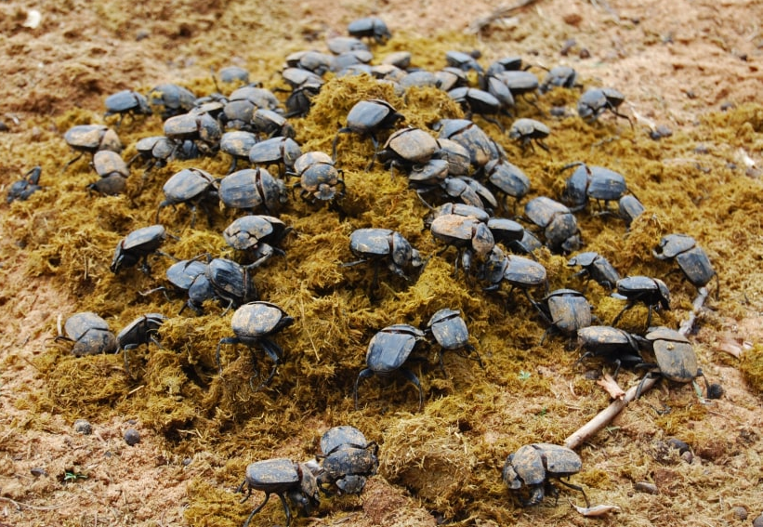
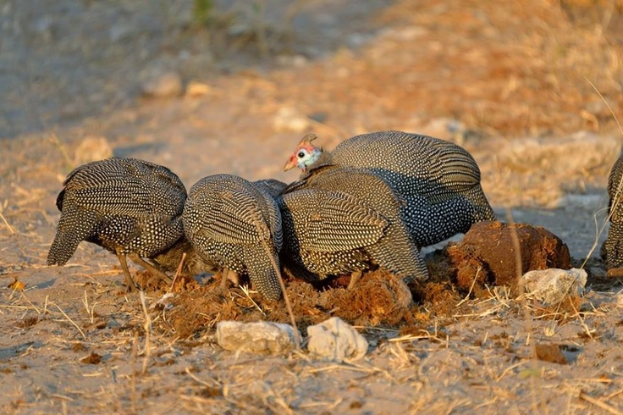
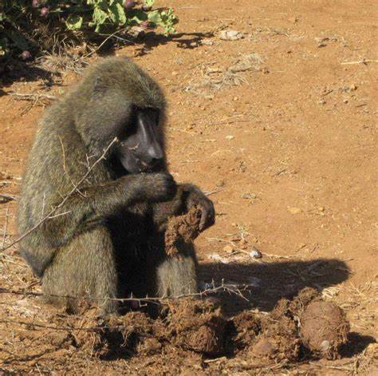
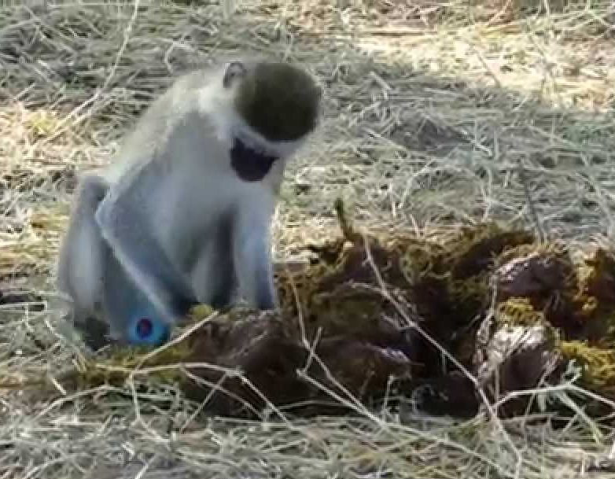
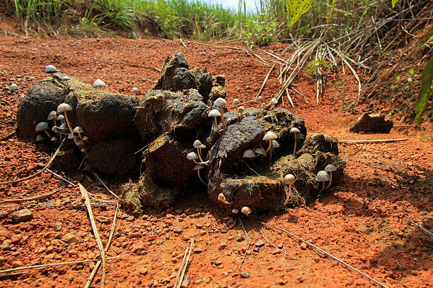
INVESTIGATE
Let’s notice and wonder… What are these organisms doing with the elephant poop?

Slide 7
Seeds in soil
Compare and contrast
Elephant poop

Slide 8
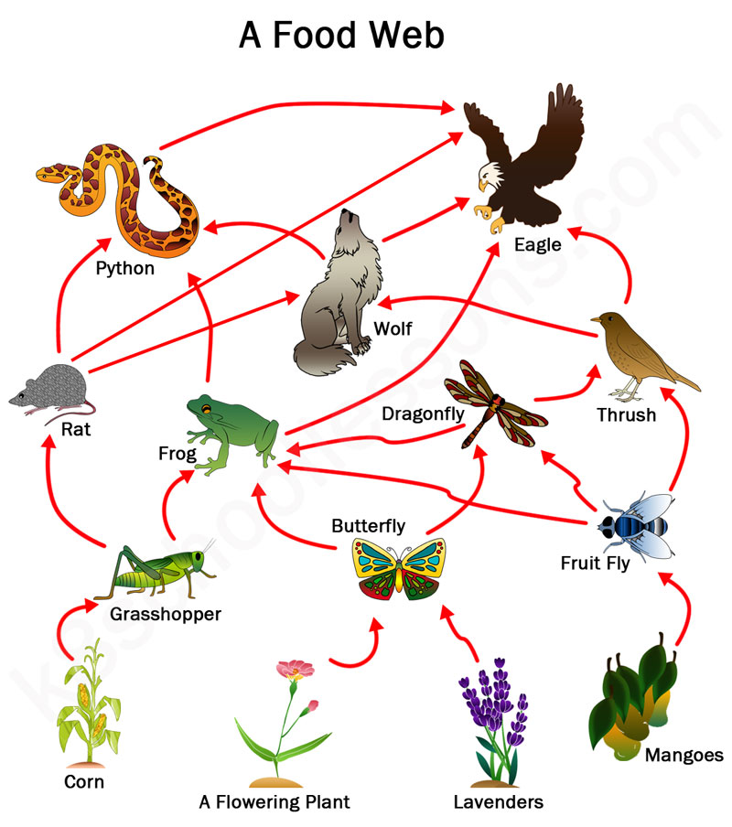
Flow of Energy in Ecosystems
A food web shows feeding relationships among organisms
Arrow means “gives its energy to”
Who does the rat gives its energy to?
Who does the fruit fly gives its energy to?

Slide 9
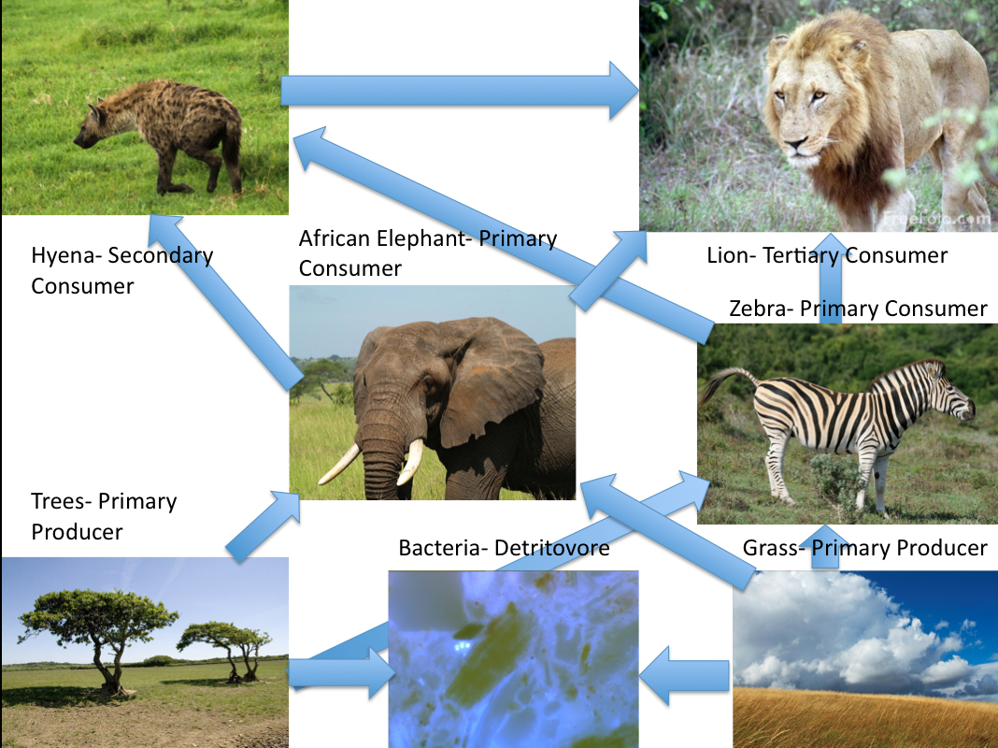
Explain flow of energy through this the food web starting at the producer
-

Slide 10
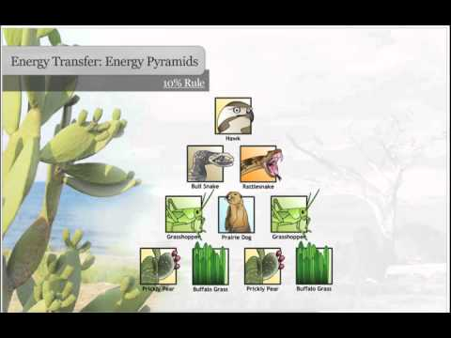
What happens to energy as it moves through a food chain?
Watch and explain the 10% rule
-
Why aren’t there 6 trophic levels in a food chain?
-
https://web.microsoftstream.com/video/69b0baf5-d1ba-4874-9ddd-5beb7f9e44e7

Slide 11
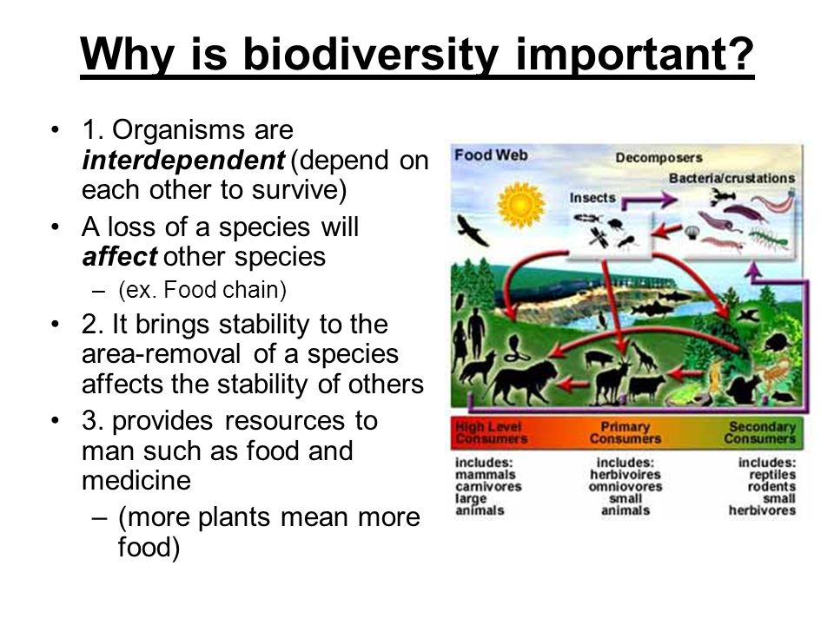
Biodiversity bio=life diversity=variety

Slide 12
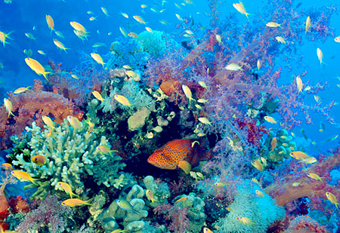
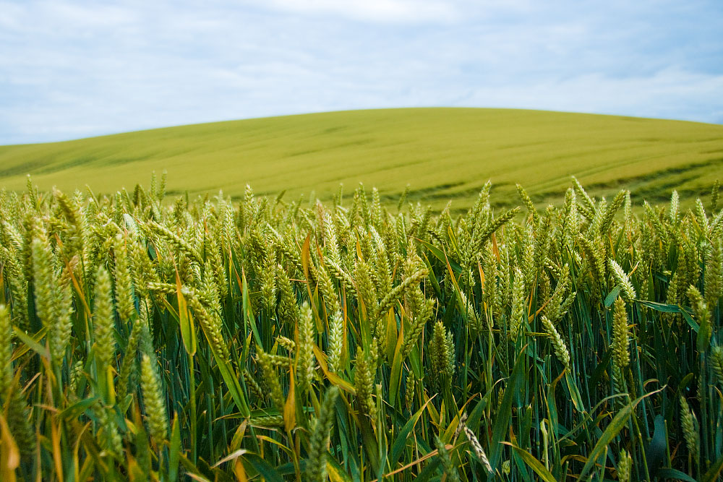
Ecosystem with HIGH biodiversity
Ecosystem with LOW biodiversity
Many different species
-HIGH biodiversity=more stability!
Only 1 type species

Slide 13
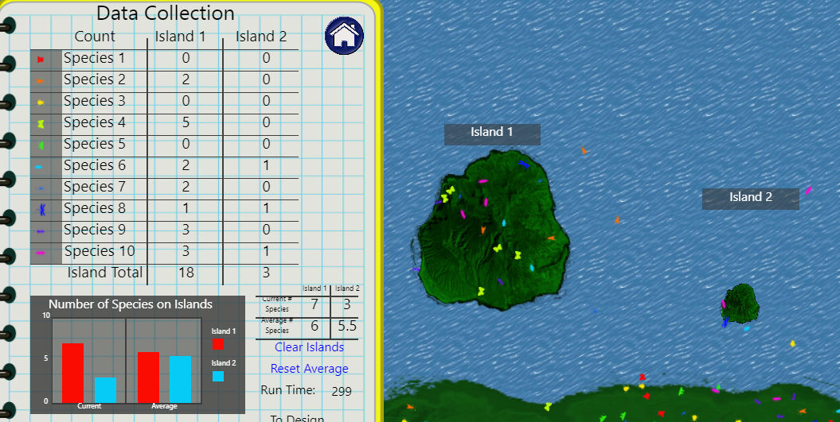
Size of island affects biodiversity
Bigger islands have--- (more/less) species
N
18 species
3 species

Slide 14
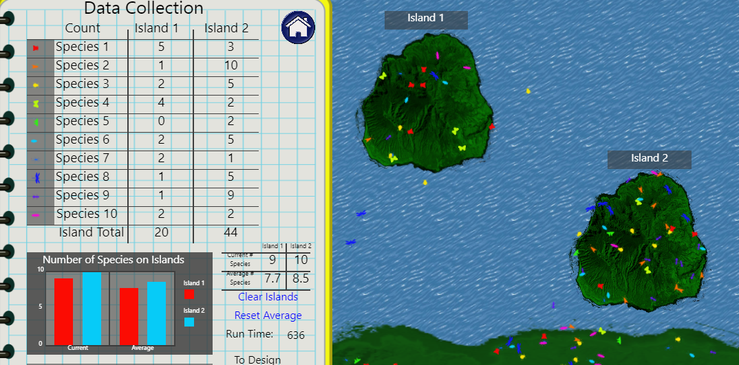
Distance from mainland affects biodiversity
Closer islands have--- (more/less) species
20 species
44 species

Slide 15
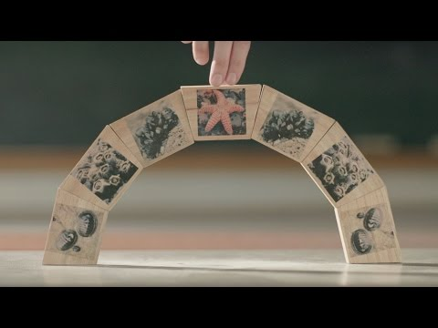
Elephants as keystone species
Elephants are among the most intelligent of the creatures with whom we share the planet, with complex consciousnesses that are capable of strong emotions. Across Africa they have inspired respect from the people that share the landscape with them, giving them a strong cultural significance. As icons of the continent elephants are tourism magnets, attracting funding that helps protect wilderness areas. They are also keystone species, playing an important role in maintaining the biodiversity of the ecosystems in which they live.
During the dry season, elephants use their tusks to dig for water. This not only allows the elephants to survive in dry environments and when droughts strike, but also provides water for other animals that share harsh habitats.
When forest elephants eat, they create gaps in the vegetation. These gaps allow new plants to grow and create pathways for other smaller animals to use. They are also one of the major ways in which trees disperse their seeds; some species rely entirely upon elephants for seed dispersal.
On the savannahs, elephants feeding on tree sprouts and shrubs help to keep the plains open and able to support the plains game that inhabit these ecosystems.
Wherever they live, elephants leave dung that is full of seeds from the many plants they eat. When this dung is deposited the seeds are sown and grow into new grasses, bushes and trees, boosting the health of the savannah ecosystem.
Watch and take notes
-
-
-
https://web.microsoftstream.com/video/7d10b459-a691-4f48-be4b-1668175e4a62

Slide 16
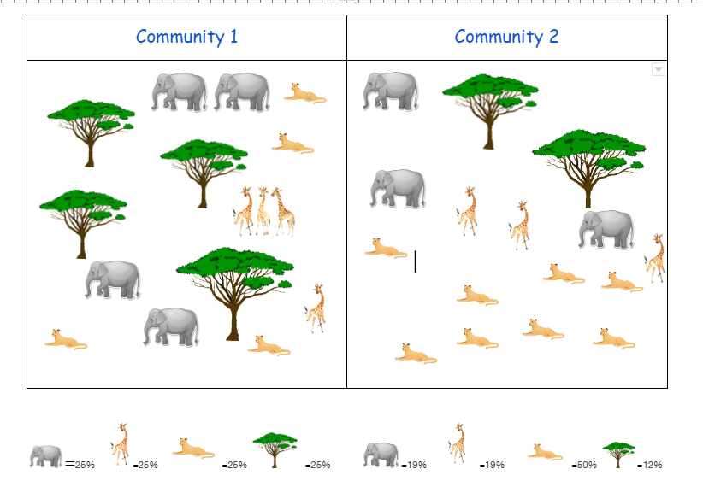
Biodiversity Reading
Did you ever wonder why some environments had dozens of different organisms that lived there, while others seemed to be inhabited by only a few kinds of organisms? The biodiversity of an ecosystem acts as an indicator of overall ecosystem health, and can tell you a lot about that ecosystem. There are several different methods that can be employed to measure ecosystem biodiversity. One such measure is the Simpson’s Diversity Index.
Biodiversity will increase naturally as succession occurs in an ecosystem--as an ecosystem ages and reaches its climax community, the number of species occupying various niches increases which can act as an indicator of ecosystem stability. There are two factors that comprise biodiversity: species richness and species evenness. Species richness refers to the number of varied species that occupy an ecosystem, while species evenness refers to the number of each species that occupies an ecosystem. The diagram below provides a visual explanation for these concepts:
What is the difference between species evenness and species richness?
-

Slide 17
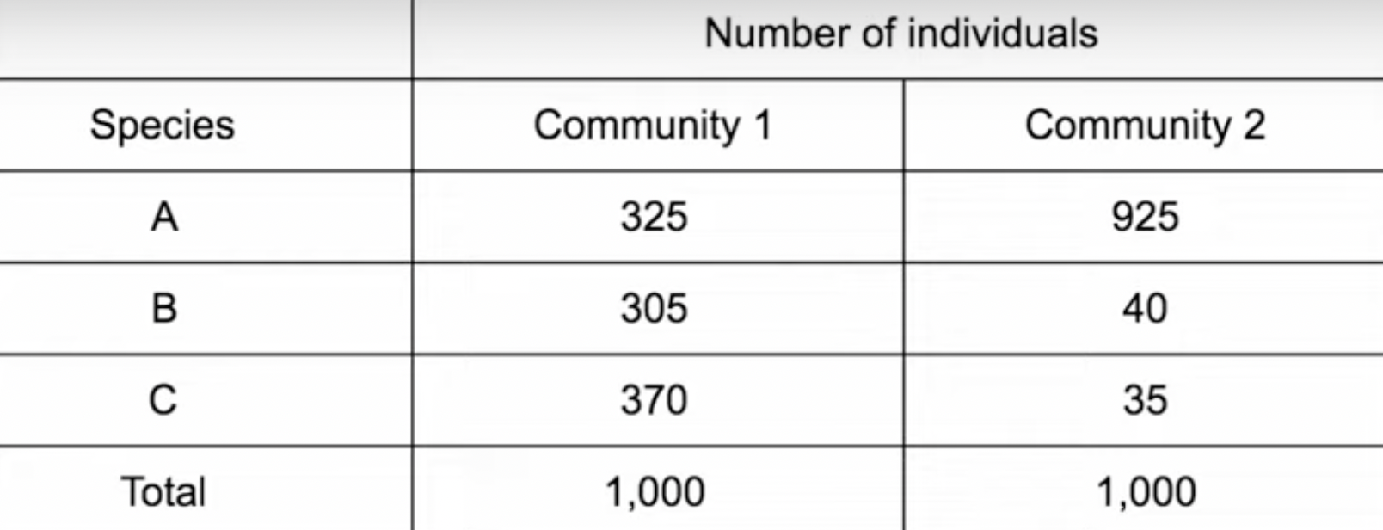
Which community is the most diverse?Make a guess
-

Slide 18
Diversity Index = 1-nN2 | n = the total number of organisms of a particular species N = total number of organisms of all species
Ecosystems such as old-growth forests and rainforests tend to be quite complex in their biodiversity and are stable. However, not all ecosystems have the same level of biodiversity. Humans have altered many ecosystems to reduce their complexity and diversity by converting previously unused forests into cropland, for example. The conversion of forests into croplands reduces biodiversity by creating monocultures (all the same species), which presents several problems. Nature’s tendency to increase biodiversity through succession is something humans battle in an attempt to maintain these monocultures. This is often done with the use of pesticides and herbicides which kill off undesirable species, but that also tend to create other problems when these substances are used to make it easy to harvest a crop for human use.
The Simpson’s Diversity Index is used to determine how biodiverse an area is. The formula we will use looks like this:
The index has values from 0 to 1. A large index value indicates a higher degree of biodiversity and a stable ecosystem with many niches and little competition, while a lower value indicates a lower degree of biodiversity which may indicate an ecosystem with a few dominant species and a greater degree of competition.

Slide 19
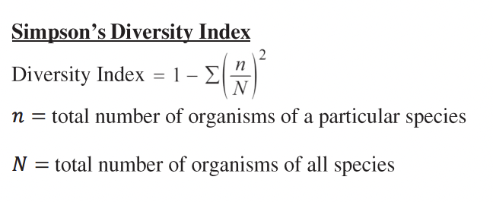
Simpson Diversity Index

Slide 20
What is the Simpson Diversity Index for Community 2?
Community 1--
1- [ (n/N)² + (n/N)² + (n/N)²]
1 – [ (325/1000)² + (305/1000)² + (370/1000)²]
1 – [ 0.106 + 0.0930 + 0.137]
1 – [0.336]
Answer: 0.664
Community 2--
1- [ (n/N)² + (n/N)² + (n/N)²]
-

Slide 21
Community 2--
1- [ (n/N)² + (n/N)² + (n/N)²]
1 - [(925/1000)² + (40/1000)² + (35/1000)²]
1 - [0.856 + 0.0016 + 0.001225]
1-.859
Answer=0.141

Slide 22
What does the diversity index value mean?
The larger the SDI the more diverse the community.
When ecosystems are more diverse, they are better able to withstand environmental stressors/changes. When a more ecologically complex ecosystem is impacted by human activities and other environmental pressures, there are likely to be organisms and interactions among organisms that can continue to exist despite the impact.

Slide 23
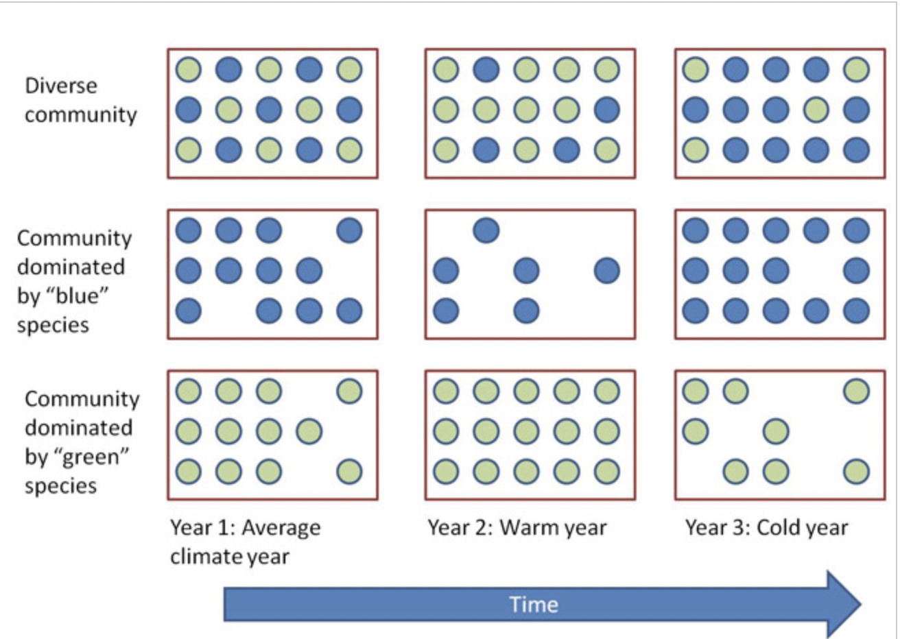
Why is diversity important?
Helps maintain ecosystem stability.

Slide 24
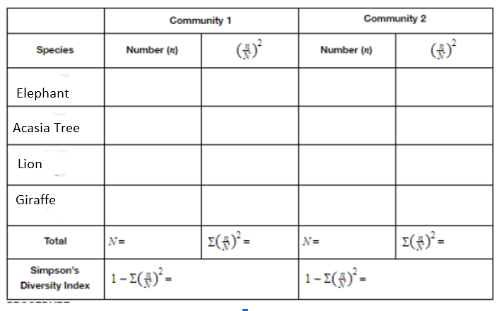
Calculate Simpson’s Diversity for each community
-
-
-
-
n = the total number of organisms of a particular species
N = total number of organisms of all species
With this index, 1 represents infinite diversity and 0, no diversity
-
-
-
-
-
-
-
-
-
-
-
-
-
Which community has more biodiversity? What is your evidence?

Slide 25
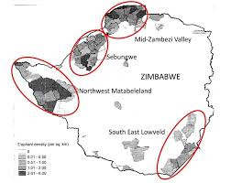

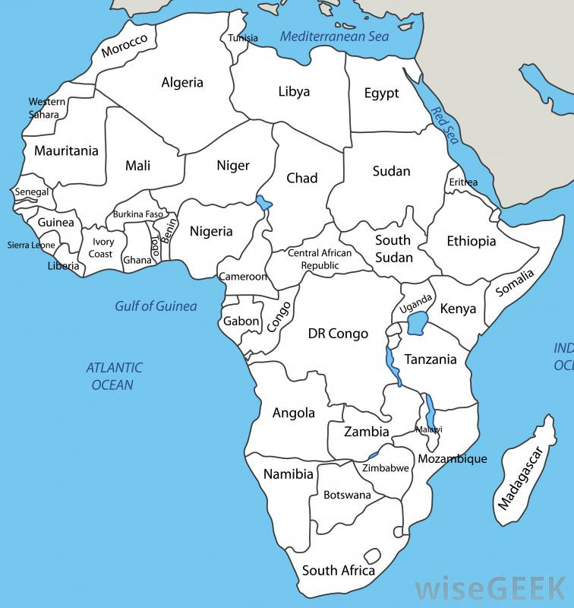
Elephants of Zimbabwe
https://qz.com/africa/2005322/zimbabwe-looks-to-elephant-hunting-for-revenue-lost-during-covid/
Describe the state of elephants of Zimbabwe
Color Zimbabwe on map
Scan, read, and describe
https://qz.com/africa/2005322/zimbabwe-looks-to-elephant-hunting-for-revenue-lost-during-covid/

Slide 26
This is Part I of the Elephant Slides.
Please do these at your own pace, filling in highlighted portions on most slides and/or worksheet
Thanks for your hard work on slides

Slide 27
Worksheet 2 (8.3)

Slide 28
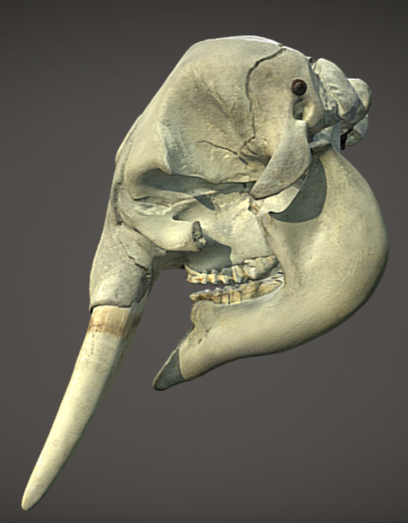

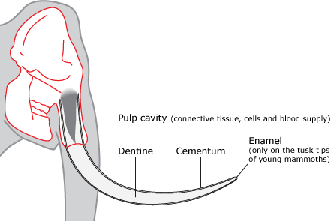

Investigate: Elephant Tusks
Measure the elephant tusk shown in diagram in cm
The pulp cavity is connected to the elephant’s face. How much of the tusk is in the elephant’s skull?
Look at a 3D model of an elephant skull. Pose a question about elephant tusks

Slide 29
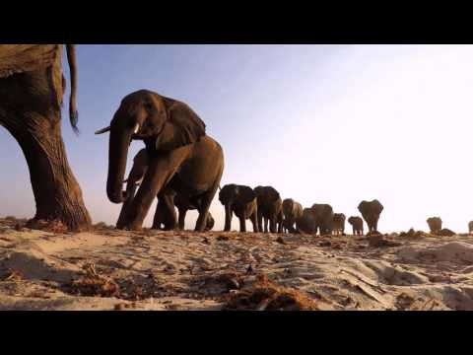
Communication among elephants
What did you find most interesting?
-
-
https://web.microsoftstream.com/video/59d2511c-a108-4fe0-92af-b1fe95b9d09e

Slide 30
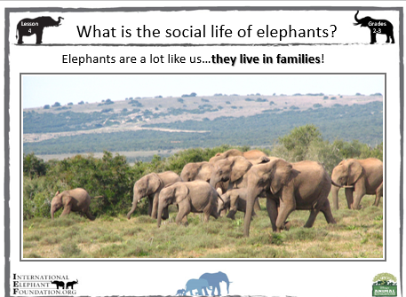
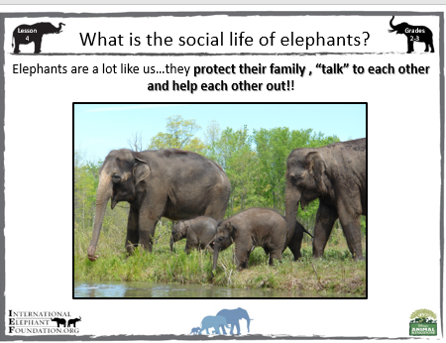
Elephants live in tightly-bonded female-led herds. This is led by the oldest and often largest female in the herd, called a matriarch. Herds usually consist of 8-100 individuals, depending on terrain and family size. When a calf is born, it is raised and protected by the whole matriarchal herd.

Slide 31
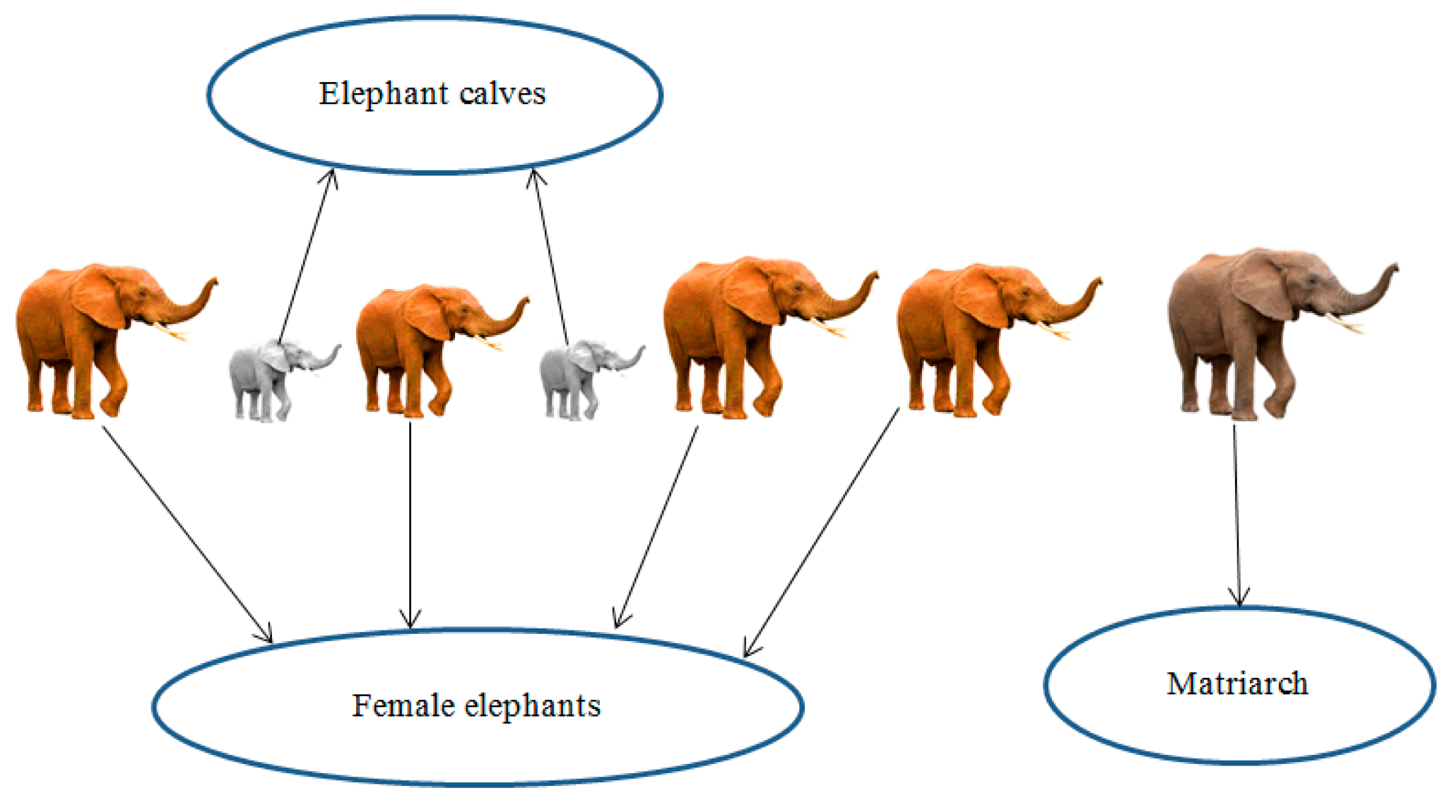
Claim: Cooperative Behavior increase fitness.
Elephants live in tightly-bonded female-led herds. This is led by the oldest and often largest female in the herd, called a matriarch. Herds usually consist of 8-100 individuals, depending on terrain and family size. When a calf is born, it is raised and protected by the whole matriarchal herd.
Advantages to cooperation
-
-
-

Slide 32
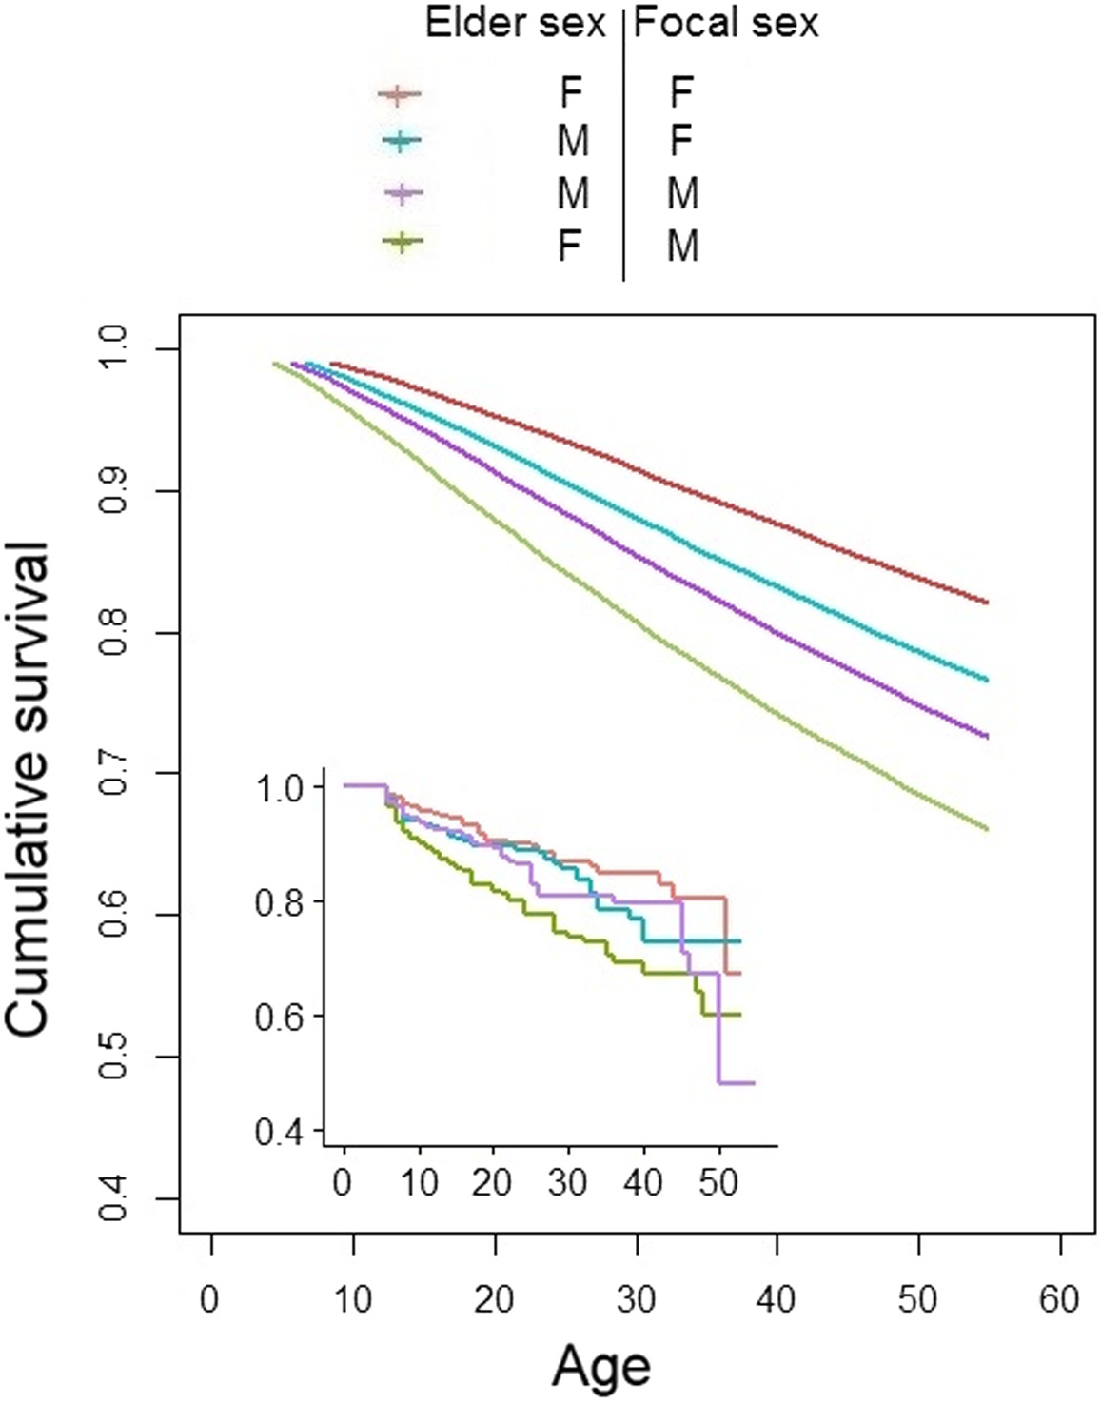

Slide 33
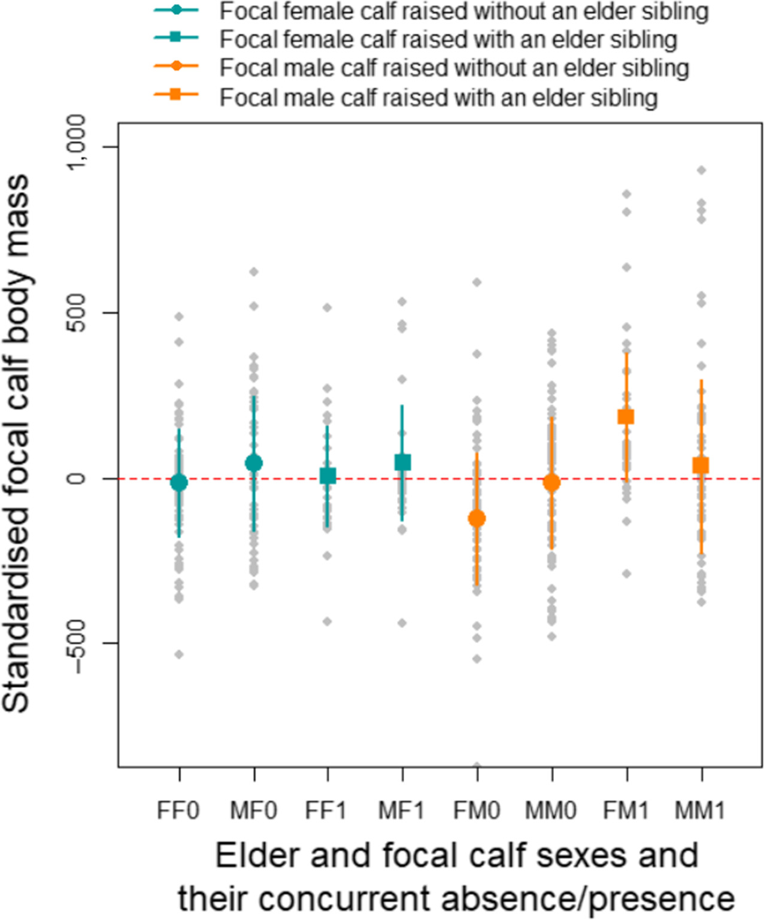
Claim: Cooperative Behavior increases fitness and success of young elephants.
Use the graph to provide at least 2 pieces of evidence:

Slide 34
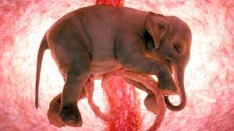
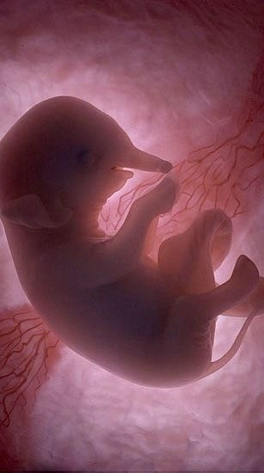
Elephants are K species. Did you know that they are pregnant for 18-22 months?? How might this slow the conservation effort to save elephants?

Slide 35
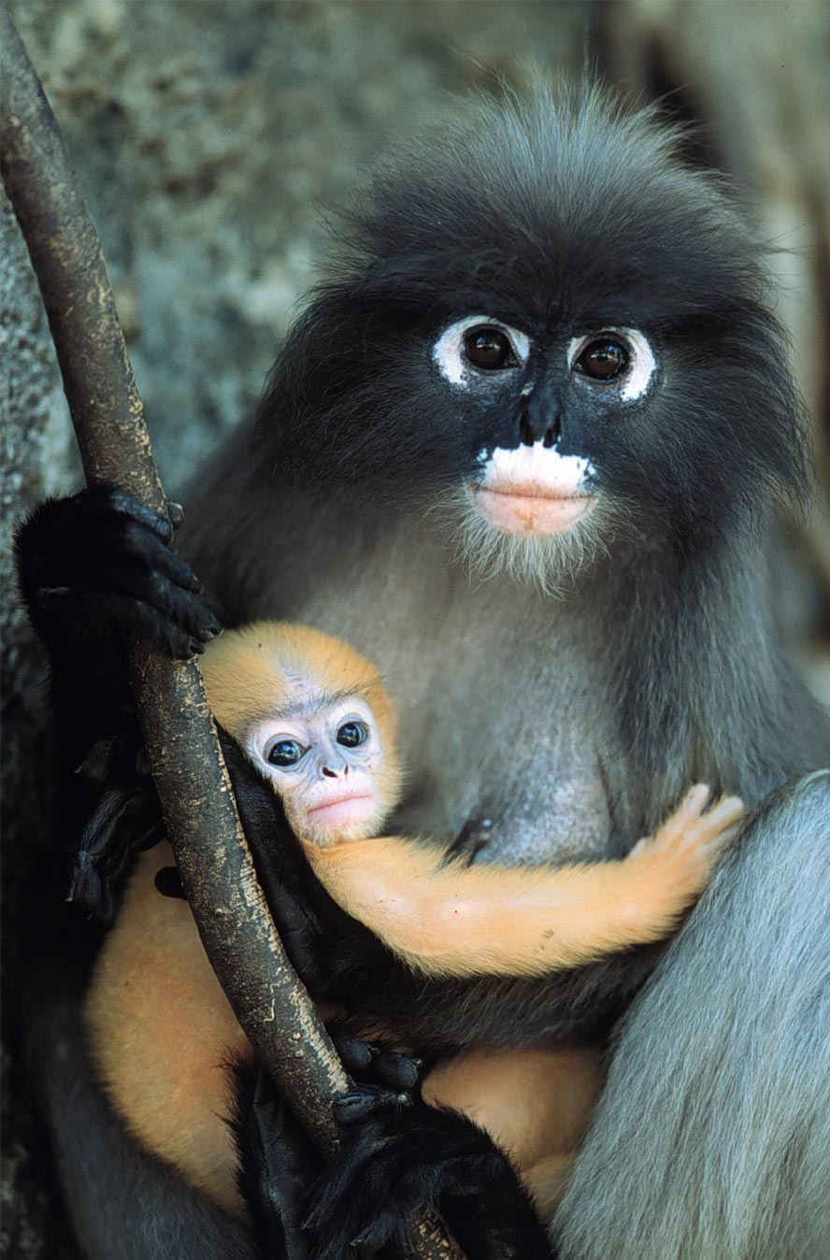
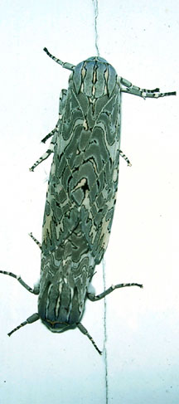
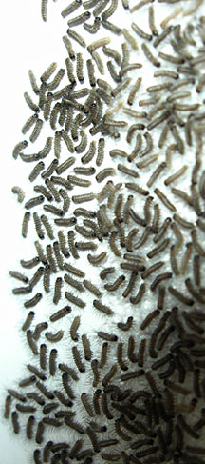
Reproductive strategies
K-selected
Number & size of offspring
vs.
Survival of offspring or parent
K-selected
late reproduction
few offspring
invest a lot in raising offspring
primates
coconut
r-selected
early reproduction
many offspring
little parental care
insects
many plants
r-selected

Slide 36
What is the advantage to k-selection?--
What is the advantage to r-selection?--
K-selection | r-selection
Live around K | Exponential growth
High prenatal care | Little or no care
Low birth numbers | High birth numbers
Good survival of young | Poor survival of young
Density-dependent | Density independent
ie. Humans | ie. cockroaches

Slide 37
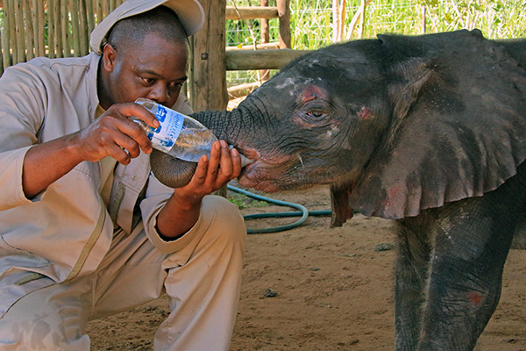
Optional…meet the orphan calves
https://elephantswithoutborders.org/elephant-orphanage/meet-the-calves/

Slide 38
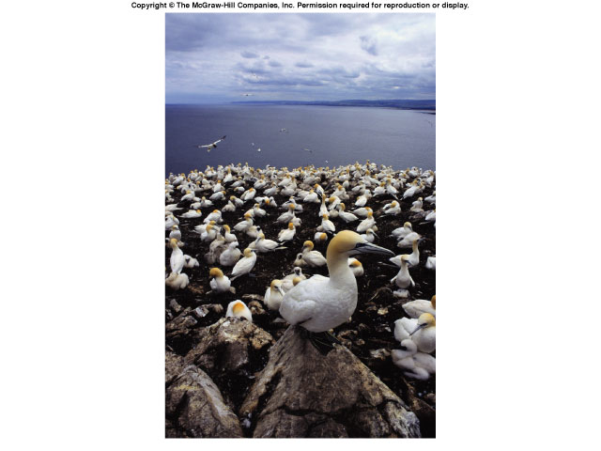
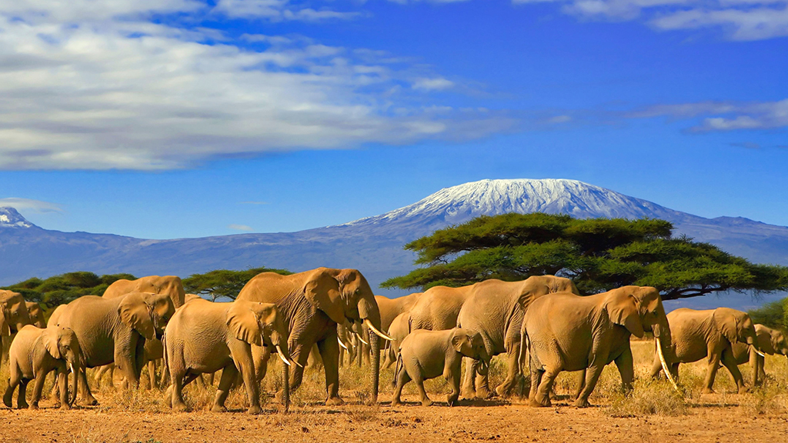
Life takes place in populations
Population
group of individuals of same species in same area at same time
rely on same resources
interact
interbreed
Population Ecology: What factors affect a population?

Slide 39
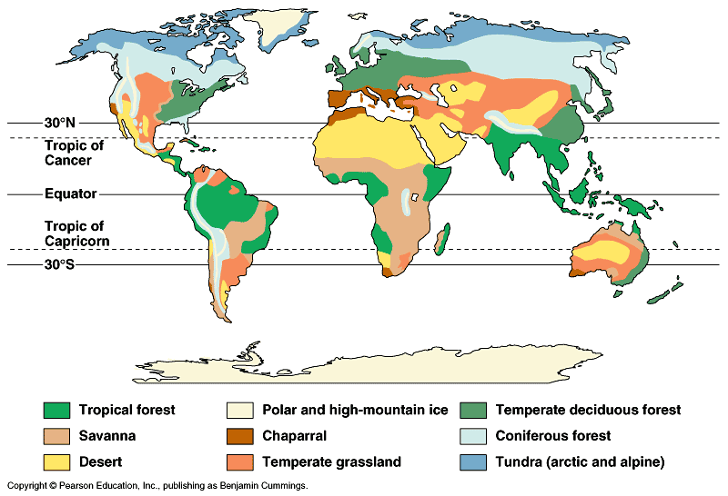
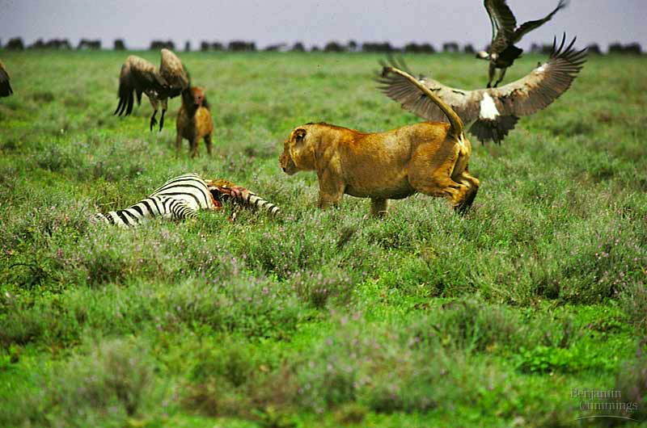
Factors that affect Population Size
Abiotic factors
sunlight & temperature
precipitation / water
soil / nutrients
Biotic factors
other living organisms
prey (food)
competitors
predators, parasites, disease

Slide 40
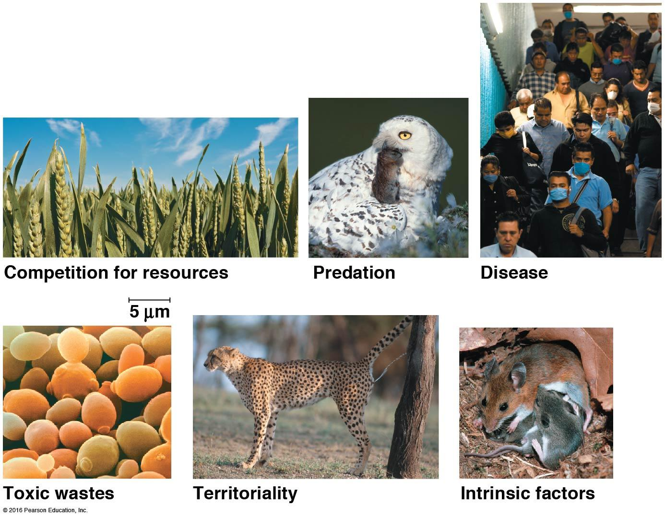
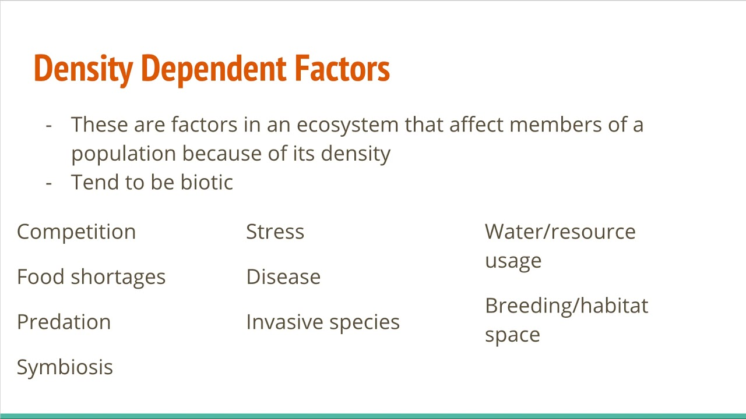
Density-Dependent Factors
Density-dependent means the larger the population the MORE the population is impacted

Slide 41
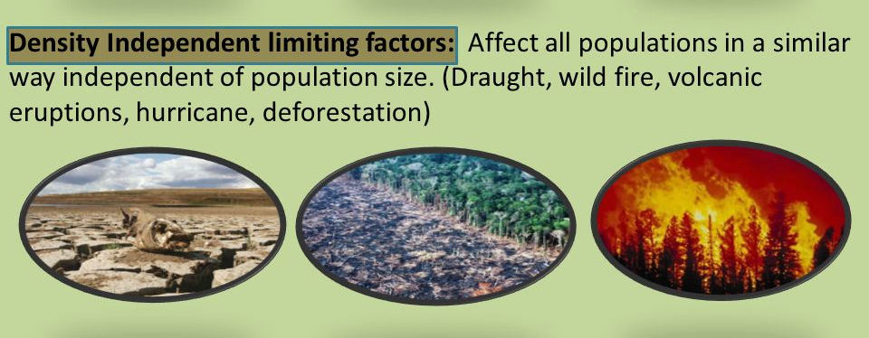
Density Independent Factors

Slide 42
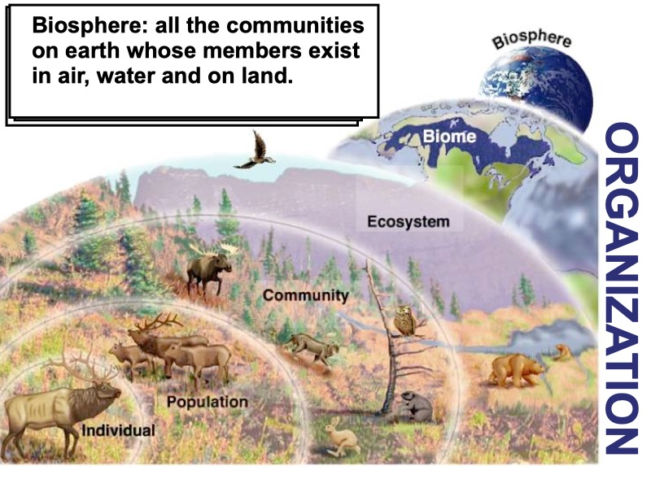
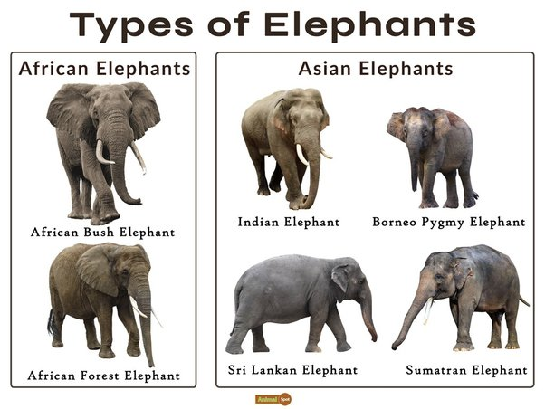

Populations of Elephants
What makes a population?
What are density dependent factors that affect elephants?
What are density independent factors that affect elephants?

Slide 43

Using info from graph,
how have African elephant populations changed over time?

Slide 44

Using data table, what species are at risk of extinction today?

Slide 45

Threats
-
-
Read information from the San Diego Zoo website regarding population statistics to see what common threats elephants face: http://ielc.libguides.com/c.php?g=692888&p=4908857

Slide 46


How much is your face worth?
What stood out from this PSA?
https://web.microsoftstream.com/video/59d2511c-a108-4fe0-92af-b1fe95b9d09e

Slide 47

Tusklessness Population

Slide 48



Watch this video about a unique elephant population
https://web.microsoftstream.com/video/b3f3cb69-2f42-41af-87c3-52b2d6d8754e
What is unusual about the elephant populations found in Gorongosa now?
How does an elephant use its tusks?
What would probably happen to a male elephant that doesn’t have tusks?
Therefore, tusklessness in male elephants is a (rare/common) trait.
How did the civil war affect elephant populations?
Dr. Poole noticed a high proportion of tuskless elephants after the war. But why did males still have their tusks?
What was the selective pressure that increased the numbers of tuskless elephants?
Explain how this selective pressure shifted the population to be more tuskless.

Slide 49

Scientific Explanation of Evolution by Natural Selection
Write an explanation based on natural selection for the high incidence of tusklessness among female elephants in Gorongosa.Highlight vocab: variation, differential reproduction, trait, variation, inherit, DNA
Explanation here:
-
-

Slide 50
Review Punnett squares
In elephants, no tusks (t) is sex-linked recessive tusks (T). If a tuskless female mates with a male with tusks, what % females and males will be tusk-less?
%__tusk-less females
%__tusk-less males
In elephants, no tusks (t) is sex-linked recessive tusks (T). If a pure tusked female mates with a male without tusks, what % females and males will be tusk-less?
-
-
-
-
%__tusk-less females
%__tusk-less males
-
-
-
-

Slide 51
Review Punnett squares
In elephants, big ears eyes (E) is dominant to small ears(e). If a homo dominant parent mate with a homo recessive parent, what percent will have small ears?
%__small ears
In elephants, big ears eyes (E) is dominant to small ears(e). If two heterozygous parents mate, what percent will have small ears?
%__small ears
-
-
-
-
-
-

Slide 52


Elephants of Tanzania
https://tanzania.wcs.org/Species/Elephant.aspx
Color Tanzania on map
Scan and read https://tanzania.wcs.org/Species/Elephant.aspx
Describe the population of elephants of Tanzania

Slide 53
This is Part 3 of the Elephant Slides.
Please do these at your own pace, filling in highlighted portions on most slides
Thanks for your hard work

Slide 54
Worksheet 3
(8.3, 8.4, 8.5)

Slide 55


Teacher Notes
Can add an electrophoresis lab

Slide 56

-
-

Slide 57

-
-

Slide 58


Slide 59

Community relationships
Example 1: Oxpeckers are birds that land on elephants, where they eat lice, ticks, and other parasites living on elephants' skin and hair.
What type of relationship is this?
-
Symbiosis- two species living in close contact with each other
Mutualism- both species benefit (ex: bacteria in cow gut)
This is a ++ because -
Parasitism- one species benefits while the other is harmed (ex: tick on a dog)
This is + - because -
Commensalism- one species benefits, but the other is neither helped nor harmed (ex: birds building nests in a tree)
This is +0 because: -

Slide 60

-
-
-
-
-
-

Slide 61



Elephant relationships with other species
Example 2: The dung beetle retrieves its nourishment from the elephant’s dung, while on the other hand, the elephants are totally indifferent to what happens to its waste.
What type of relationship? Fill into chart
Example 3: The elephant-specific intestinal fluke Protofasciola robusta, likely to be an ancestral species within the Fasciolidae (Lotfy et al., 2008), has been associated with intestinal tissue damage, hemorrhage and death in free-ranging African elephants (Vitovec et al., 1984; Obanda et al., 2011)
What type of relationship? Fill into chart
Example 4:In Eritrea, a country in the Horn of Africa, olive baboons and elephants have formed a symbiotic relationship. The baboons drink from water holes dug by the elephants, and the elephants rely on baboons sitting in the treetops to alert them to danger.
What type of relationship? Fill into chart

Slide 62

Look at the African continent, make observations on the elephant populations?
-
-
-
Pose a question about populations in different countries
-

Slide 63


What is the rate of growth in this population between 1950 and 1960?
Is this logistic or exponential growth?

Slide 64

What is the rate of growth in this population between 1950 and 1960?Show me the math!!
Dy/dt
Is this logistic or exponential growth?

Slide 65
Exponential growth
The J-shaped curve
This is an example of positive feedback
1 pair of elephants could produce 19 million elephants in 700 years without limiting factors
Numbers
Time
© 2016 Paul Billiet ODWS

Slide 66

Population growth
K
3
2
Phase 2: Decline or transitional phase
Limiting factors slowing population growth.
Numbers
Phase 1: Log or exponential phase
Unlimited population growth
The intrinsic rate of increase (r)
Abundant food, no disease, no predators etc
1
© 2016 Paul Billiet ODWS
Time

Slide 67


Slide 68
Show Me the Math

Slide 69
Solve 6 problems and then self grade.
Cell B will change color if correct
Self grading worksheet

Slide 70
There are 252 elephants in a population. There is no net immigration or emigration. If 47 elephants die and 32 elephants are born in one month, what is the population size at the end of the month? Round to the nearest whole number.
Notes:
🍐 This is a Pear Deck Number Slide
🍐 To edit the type of question, go back to the "Ask Students a Question" in the Pear Deck sidebar.

Slide 71
In a population of 600 squirrels, the per capita birth rate in a particular period is 0.06 and the per capita death rate is 0.12.
What is the per capita growth rate of the population? Round to the nearest hundredth.
Notes:
🍐 This is a Pear Deck Drawing Slide
🍐 To edit the type of question, go back to the "Ask Students a Question" in the Pear Deck sidebar.

Slide 72

dN/dt = rN
r = B - D = intrinsic rate of increase
N = population size
There are 190 elephants. The population is under carrying capacity. If r = (-0.093) elephants/year, predict the population size next year. Round to the nearest whole number.
Notes:
🍐 This is a Pear Deck Drawing Slide
🍐 To edit the type of question, go back to the "Ask Students a Question" in the Pear Deck sidebar.

Slide 73
#
dN/dt = rN
r = B - D = intrinsic rate of increase
N = population size
There are 190 elephants. The population is under carrying capacity. If r = (-0.093) elephants/year, predict the population size next year. Round to the nearest whole number.
Notes:
🍐 This is a Pear Deck Number Slide
🍐 To edit the type of question, go back to the "Ask Students a Question" in the Pear Deck sidebar.

Slide 74
dN/dt = rN
r = B - D = intrinsic rate of increase
N = population size
There are 190 elephants. The population is under carrying capacity.
If r = (-0.093) elephants/year, predict the population size next year. Round to the nearest whole number.
dN/dt = (-0.093)190 New population size = 172
(190 -18 = 172)
= -17.67 or apx. -18 frogs
Notes:
🍐 This is a Pear Deck Drawing Slide
🍐 To edit the type of question, go back to the "Ask Students a Question" in the Pear Deck sidebar.

Slide 75


Slide 76

If rmax = 1.0 and carrying capacity (K) = 1,500, calculate the population growth rate, where population size (N) = 1,600. What is happening to this population?

Slide 77
If a population of dandelions is currently 40 individuals and r_{max} = 0.2 dandelions/month per capita, predict how many dandelions would be in a population the following month if the carrying capacity is 70 elephants.

Slide 78
If a population of dandelions is currently 40 individuals and r_{max} = 0.2 dandelions/month per capita, predict how many dandelions would be in a population the following month if the carrying capacity is 70 elephants.
dN/dt = 0.2(40)(70-40/70)
= 8(0.43)
= 3.44 apx. 3, population increasing to 43

Slide 79

A lion kills and eats an elephant. Cellular respiration begins.
Say steps out loud as you move your finger across screen (right/left brain). How is ATP made in glycolysis, Krebs, and ETC?

Slide 80

How do elephants react to being chased?
Say steps out loud as you move your finger across screen (right/left brain)
What molecules amplify the signal?

Slide 81



Elephants of South Africa
https://www.krugerpark.co.za/africa_elephant.html#:~:text=In%20South%20Africa%20the%20Addo,at%2040%20locations%20to%20date.

Slide 82
This is Part 4 of the Elephant Slides.
Please do these at your own pace, filling in highlighted portions on most slides
Thanks for your hard work on slides

Slide 83
Worksheet 4--in progress

Slide 84

Design an elephant reserve--in progress

Slide 85


Human Impacts on elephants

Slide 86


Solutions
To get there, we need to:
Prevent illegal killing.
Protect elephant habitat.
Monitor elephant numbers, poaching rates, and threats to elephant habitat at key sites in Africa and Asia.
Reduce ivory trafficking.
Reduce the demand for ivory.
Petitioning can be a useful way to impress on politicians that there is widespread support for an issue. In the UK a petition to end the domestic ivory trade got over 100,000 signatures and forced a debate in parliament.
Lobbying politicians sounds like a big job; in fact politicians in many countries are very willing to listen to voters. In Canada Elephanatics has been working with MP Mike Farnworth, who has now introduced a private member’s bill calling for a ban on the sale of ivory and rhino horn. Search out sympathetic politicians and then support them with petitions and letters to other MPs.
Marches and demonstrations can show support for policy that will protect elephants. Groups in over 130 countries including Kenya, New Zealand and the US organised local demonstrations as part of the annual Global March for Elephants and Rhinos last year.
Educating people about the situation for elephants can be very effective. Youth 4 African Wildlife in South Africa offers a conservation internship for young adults and also runs a great community outreach programme.
Get creative A group of photographers and writers published a book (called 32 Souls, because Laotians believe that elephants and humans have 32 life spirits that guard us from misfortune and ill health) to raise money for the Elephant Conservation Centre in Laos.

Slide 87


Your goal is to determine which of the 7 populations of elephants you will represent in your conservation grant application.
Populations can be found in Botswana, Jamalya, Mozambique, South Africa, Tanzania, Uganda, and Zimbabwe.
Which do you pick to conserve?
-
Why?
-

Slide 88


Point --- is the nearest ancestor

Slide 89

What characters belong to the elephant?
-
-
-
-

Slide 90

What characters belong to elephant?
-
-
-
-
Who shares a common ancestor with elephant?
-

Slide 91

Plants are producers--review the light reaction and Calvin cycle. Say steps out loud as you move your finger across screen (right/left brain)
How are the products on the light reaction used in the Calvin Cycle?

Slide 92

Plants link their glucose into starch through dehydration synthesis. Explain dehydration synthesis -
Elephants digest plants and perform hydrolysis. What does that mean?
-

Slide 93

Elephants of Mozambique
https://mozambique.wcs.org/About-Us/News/ID/12919.aspx#:~:text=Mozambique%20has%20an%20estimated%20population,indicate%20an%20estimated%2010%2C800%20elephants.

Slide 94

Look at the map. More information about 6 countries and their elephant population follow this side.
Use it to decide on which population to save

Slide 95

Elephants of Botswana
https://www.awf.org/country/botswana

Slide 96

Elephants of Uganda
https://news.mongabay.com/2015/05/ugandas-elephant-population-has-risen-600-since-its-1980s-low/#:~:text=The%20country%20had%20only%20about,than%205%2C000%20elephants%20and%20growing.

Slide 97
Elephants of Zimbabwe
https://qz.com/africa/2005322/zimbabwe-looks-to-elephant-hunting-for-revenue-lost-during-covid/

